Slide 1
Overview
Patient
Medical bodied
Monitoring device
Cloud

Slide 2
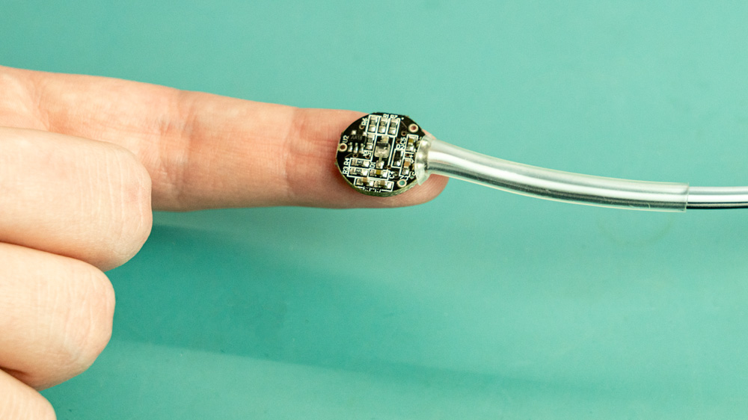
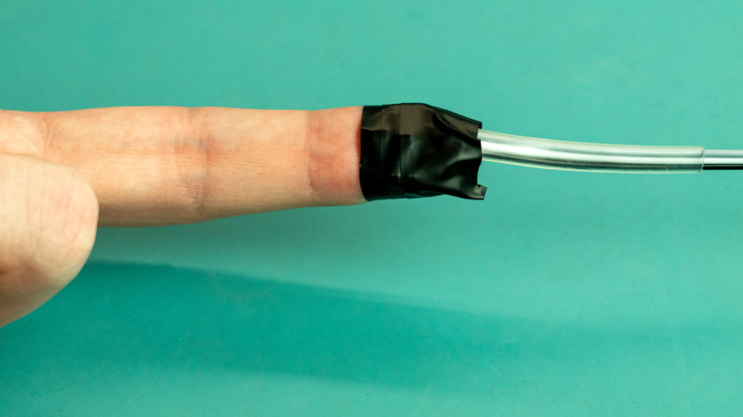
Physical connection

Slide 3
User Interface
What happends when we click here?
Heart beat
Body temperature
Blood pressure
Name
Age
More

Slide 4
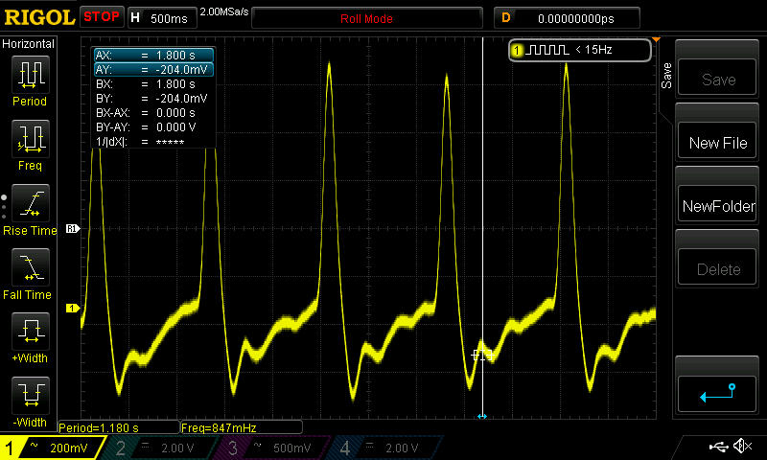
User Interface
Heart beat
Body temperature
Blood pressure
Name
Age
Norms
Peak level: 00
Critical level: 00
More

Slide 5
https://sensorkit.joy-it.net/files/files/sensors/KY-039/NewFile1.jpg https://sensorkit.joy-it.net/files/files/sensors/KY-039/heartbeat1.jpg https://sensorkit.joy-it.net/files/files/sensors/KY-039/heartbeat2.jpg
Reference images

